Slide 1
Tricking Computers into Being Smart: Building your own Neural Network
By: Aritro Majumdar

Slide 2
Live Code with Me!
Fork and Clone Repo
https://github.com/aritro6/mnist
Download Anaconda

Slide 3
How to Computers Process Images?

Slide 4
High Level Process
Take in a matrix of pixels
Identify basic image properties
Edges
Corners
Shapes
Textures
Train a model to classify properties
Model iteratively finds more complex patterns in images
Predict objects in images!

Slide 5
Forget this High Level Crap
How do you actually do it tho…?

Slide 6
Neural Networks!
More specifically…
Convolutional Neural Networks (CNN)
Ooooo Aaaaaah!

Slide 7
Our Dataset:
MNIST (Modified National Institute of Standards and Technology)

Slide 8
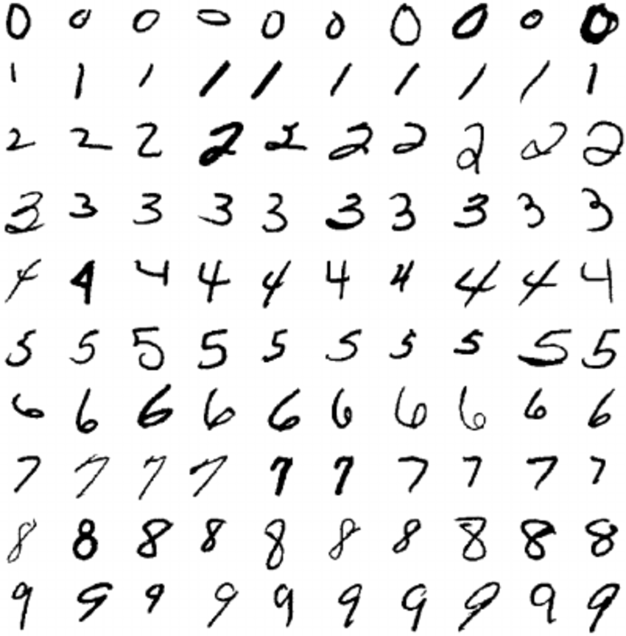
MNIST

Slide 9
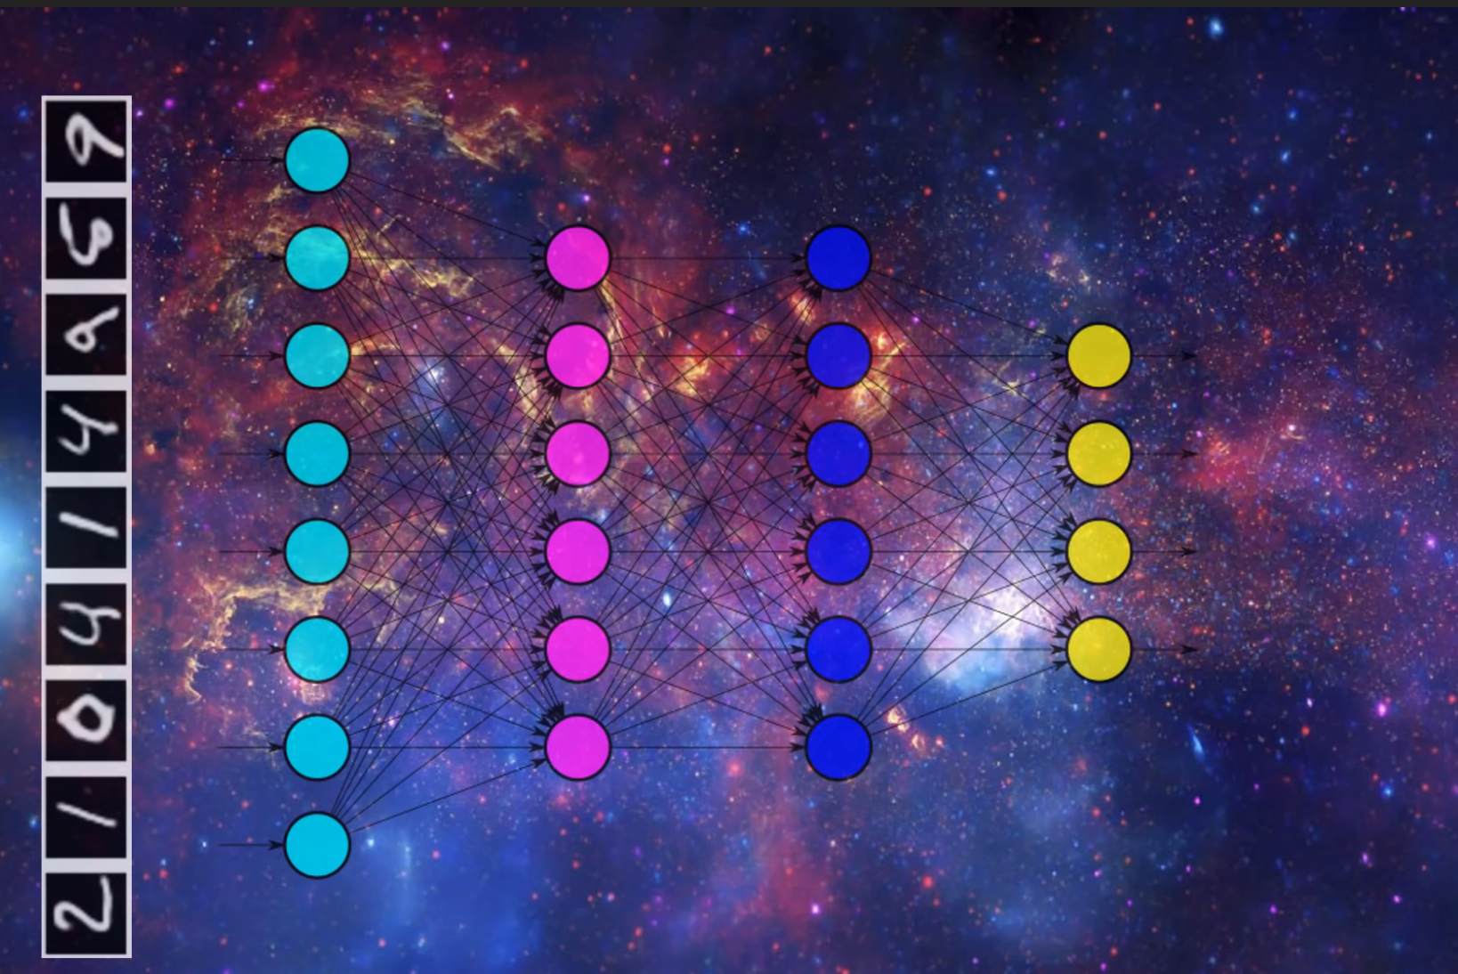
Taken from deeplizard video

Slide 10
High Level Process (Re-done for our case)
Take in a matrix of 3x3 pixels
Create a convolutional layer that creates a filter that identifies
Edges
Corners
Shapes
Textures
Etc...
Filter “slides” through every 3x3 matrix and dot products it with the filter matrix (another matrix that represents the pattern used (i.e., edges))
Build more layers with more complex filter matrices until image has been classified
Predict objects in images!

Slide 11
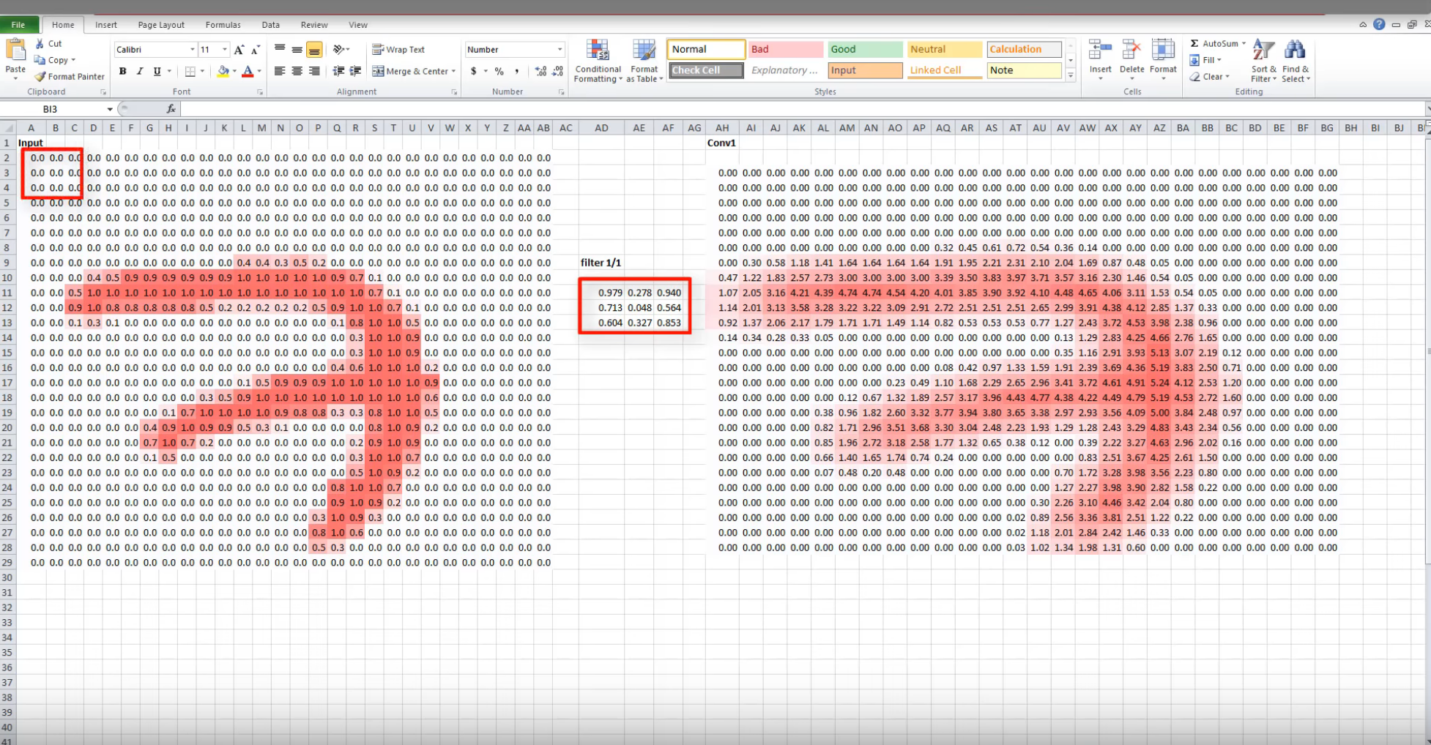
Convolutional Operations Visualized

Slide 12
Let’s Code Dis Ish!

